Slide 1
Engineering Economics
EVALUATION OF ALTERNATIVES
PRESENT WORTH METHOD

Slide 2

Economic Evaluation of Alternatives
Objectives:
To select the best alternative economically.
Understand the various bases for comparison of alternatives.
Bases for Evaluation of Alternatives:
Present worth method
Future worth method
Annual equivalent method
Capitalized cost method
Rate of return method

Slide 3
Assumptions in Economic Evaluation of Alternatives
Cash flows are known.
Cash flows are in constant-value dollars.
The interest rate is known
(Minimum Attractive Rate of Return - MARR)
Comparisons do not include consideration of the availability of funds to implement alternatives.

Slide 4
Present Worth Method

Slide 5
Present Worth Method
It is the equivalent value at the present time period of the asset, based on time value of money.
PW comparisons are generally made only between co terminated proposals to assure equivalent outcomes.
Two methods in calculating present worth:
Cost dominated cash flow diagram
Revenue dominated cash flow diagram

Slide 6
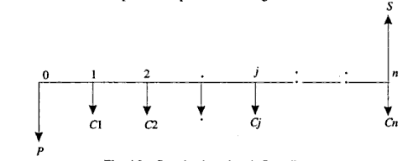

Cost Dominated Cash Flow Diagram
To compute the present worth amount of the above cash flow diagram for a given interest rate i,

Slide 7
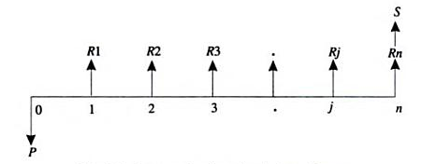

Revenue Dominated Cash Flow Diagram
Revenue dominated cash flow diagram:
To compute the present worth amount of the above cash flow diagram for a given interest rate i,

Slide 8
A construction company receives two bids for an elevator to be installed in their newly constructed apartment, the details of which are given in the table. Determine the best bid based on present worth method @ 12% interest rate.
Alternative | Initial Cost (Rs) | Service Life | Annual operating cost (Rs) | Salvage
1 | 5,80,000 | 15 | 30,800 | 75,000
2 | 6,40,000 | 15 | 29,500 | 95,000

Slide 9
Problem
The following table gives an initial outlay and the annual revenues of a production firm using three different technologies. Find the best alternative if the interest rate is 20% compounded annually.
Technology | Initail Outlay ($) | Annual Revenue ($) | Maintenance ($) | Life (Yrs)
1 | 1,300,000 | 4,00,000 | 20,000 | 10
2 | 2,100,000 | 6,50,000 | 50,000 | 10
3 | 2,300,000 | 8,60,000 | 65,000 | 10

Slide 10
COMPARISON OF ASSETS THAT HAVE UNEQUAL LIVES
When the assets have unequal lives, there must be comparison between the alternatives based on equivalent outcomes.
Two methods used for comparison are:
Common multiple method.
Study period method.

Slide 11
Common Multiple Method : (LCM)
In this method alternatives are co-terminated by selecting an analysis period which is the least common multiple (LCM) of the lives of the involved assets.
Here the assumption is that the assets will be replaced by successors having identical cost characteristics.
Ex: If the assets have life 3 and 4 years, the comparison period is 12 years.

Slide 12
2. Study period method :
Here the analysis is based on a specified duration corresponding to length of the project or the time during which the assets are in service.
Following options are available to select the study period:
The known duration of required services.
The shortest life of all competing alternatives.
The time before a better replacement becomes available.

Slide 13
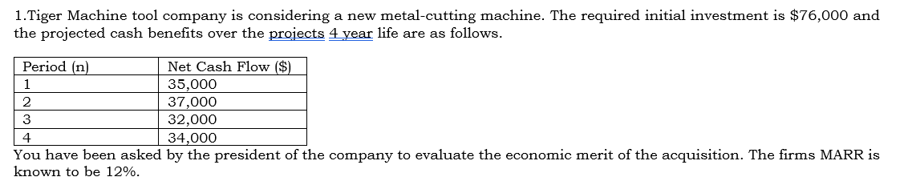

Slide 14
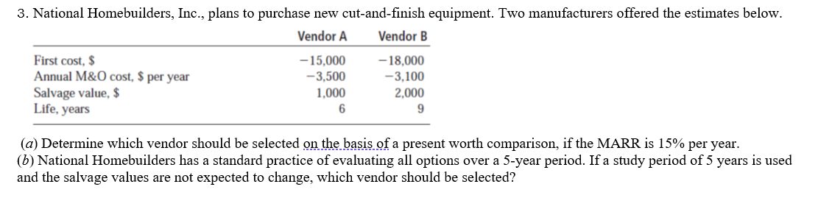

Slide 15
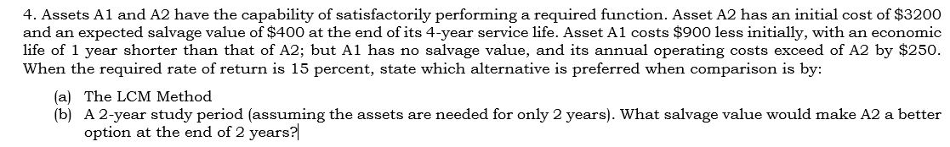

Slide 16
Project lives longer than the analysis period
1 unit of Model A’s salvage value at EOY2 = $45,000; 1 unit of Model B = $125,000

Slide 17
Project lives shorter than the analysis period
The company considers leasing equipment comparable to Model A at an annual payment of $6,000 payable at EOY

Slide 18
A British food distribution conglomerate purchased a Canadian food store chain for £75 million 3 years ago. There was a net loss of £10 million at the end of year 1 of ownership. Net cash flow is increasing with an arithmetic gradient of £_5 million per year starting the second year, and this pattern is expected to continue for the foreseeable future. This means that breakeven net cash flow was achieved this year. Because of the heavy debt financing used to purchase the Canadian chain, the international board of directors expects a MARR of 25% per year from any sale. (a) The British conglomerate has just been offered £159.5 million by a French company wishing to get a foothold in Canada. Use FW analysis to determine if the MARR will be realized at this selling price. (b) If the British conglomerate continues to own the chain, what selling price must be obtained at the end of 5 years of ownership to just make the MARR?
(FUTURE WORTH METHOD)

